Slide 1
PROJECT TITLE:Integrating LLMs for Intelligent Chatbot Support in University Web Platforms
PIP2001 Capstone Project
Review-4
Batch Number: CSD-G11
20211CSD0202 | Sparsha P
20211CSD0183 | Chandana H
20211CSD0178 | Sushmitha B S
20211CSD0200 | Sanjeetha C M
20211CSD0025 | S Yashwanth
Under the Supervision of
Dr Madhusudhan M V
Associate Professor ,Selection Grade
School of Computer Science and Engineering
Presidency University

Slide 2
Content
Introduction
Literature Review
Research Gaps Identified
Objectives
Proposed methodology
System Design and Implementation
Timeline of Project
Outcomes
Conclusion
References

Slide 3
Introduction
Chatbots, driven by artificial intelligence (AI), have become an integral part of modern digital communication [1]. They are software applications designed to simulate human conversations, providing users with immediate responses to queries and automating various tasks. Through advancements in natural language processing (NLP) and machine learning, chatbots are now capable of understanding and interacting with users in a human-like manner. From answering frequently asked questions to offering personalized recommendations, chatbots have reshaped how we engage with technology across various platforms.
Applications:
Customer Service: 24/7 support and quick query resolution.
Healthcare: Appointment scheduling and symptom checking.
Education: Student support with admissions and academic queries.
Banking & Finance: Routine financial tasks and transaction management.
Travel: Simplified bookings and real-time updates.
In Our Project: Integrating a chatbot in the university to provide 24/7 support, improve student engagement, and ease administrative tasks, enhancing the overall academic experience.

Slide 4
Literature Review
AUTHORS | TITLE OF THE PAPER | WHERE IT WAS PUBLISHED | UNDERSTANDING OF THE PAPER
Anbang Xu, Zhe Liu, Yufan Guo, Vibha Sinha, Rama Akkiraju | A New Chatbot for Customer Service on Social Media | 3. CHI 2017, ACM, Denver, CO, USA | The paper presents a conversational system (chatbot) aimed at improving customer service on social media platforms, specifically addressing the problem of delayed or unaddressed user requests
Anna Chizik and Yulia Sherberts've | Challenges of Building an Intelligent Chatbot | International Conference "Internet and Modern Society" (IMS-2020), CEUR Proceedings | The paper provides a technical overview of the complexities involved in building conversational agents, particularly the difficulties of ensuring coherent, human-like interactions.
Theodora A. Manicou , Andreas Veglias | "Employing a Chatbot for News Dissemination during Crisis: Design, Implementation and Evaluation" | Future Internet Journal, June 2020, Volume 12, Article 109. | This paper discusses the design, implementation, and evaluation of a chatbot for news dissemination during crises, specifically focusing on the COVID-19 pandemic.

Slide 5
Literature Review (contd..)
Ika Melian Untrain | Chatbots and Government Communications in Covid-19 Pandemic | Journal CommunicAsia Indonesia, Volume IX, Issue 2, July 2020 | The paper effectively discusses the relevance of chatbots as a communication tool during the COVID-19 pandemic. Using Media Richness Theory, the author argues that chatbots provide an essential channel for conveying clear, real-time information to the public.
Wagobera Edgar Kedi Chibundom Ejimuda, Courage Idemudia, Tochukwu Ignatius Ijomah | AI Chatbot Integration in SME Marketing Platforms | International Journal of Management & Entrepreneurship Research, Volume 6, Issue 7, July 2024. | The paper examines how AI chatbots are integrated into marketing platforms for small and medium-sized enterprises (SMEs) to enhance customer interaction and improve service efficiency

Slide 6
Research Gaps Identified
Limited Contextual Understanding
Dependency on Keyword-Based Processing
Lack of Multilingual Support
Inadequate Personalization
Static Knowledge Bases
Underutilization of Advanced AI Technologies
Security and Data Privacy Concerns
Ethical and Bias Challenges

Slide 7
Proposed Methodology:
1.Framework Selection: Bot press
Reason for Selection: Modular, flexible, and open-source.
Features: Built-in NLP capabilities for structured queries.
Seamless integration with web platforms.
Modular architecture for easy expansion.
2. LLM Integration Purpose: Handle complex, open-ended, context-sensitive queries.
Advantages:
Advanced natural language understanding.
Contextual interaction for diverse user queries.
3. User Authentication System
Purpose: Ensure secure and personalized interactions.
Features: User input validation (name and phone number).
Session management for personalized experiences.
4. Backend Infrastructure Components:
Relational database for storing user data and logs. Server infrastructure for scalability and performance.

Slide 8
Objectives
Improve User Experience: Provide visitors at public places with quick and automated access to frequently asked information through a chatbot, reducing the need for manual inquiry windows.
Automate Public Announcements: Enable facility administrators to broadcast important announcements to all visitors in real-time, ensuring efficient communication.
Seamless User Authentication: Implement a simple user authentication system where users provide their name and Indian phone number before accessing services, ensuring personalized support.
Enhance User Engagement: Provide 24/7 accessibility to university resources through an intelligent chatbot. Offer real-time responses to inquiries about admissions, academic support, campus events, and more.

Slide 9
Proposed Methodology:
5. Broadcast Module
Purpose: Enable real-time announcements.
Features: Dynamic updates displayed as a scrolling ticker.
User-friendly admin panel for content management.
6. Knowledge Base & Log Management
Knowledge Base: Managed via Bot press for FAQs like admissions, campus events, etc.
Log System: Records unhandled queries for further analysis.
Ensures continuous improvement by refining responses.
7. Map-Based Directions Feature:
Integrated university map to provide navigation support. Real-time guidance for new students and visitors.
8. Continuous Learning LLM Updates:
Fine-tuned with additional data for improved accuracy.
Admin Feedback Loop: Logs analysed to update knowledge base and refine system responses.

Slide 10
System Design and Implementation
1.Purpose: Simplifies access to university services, improves user experience, and provides automated assistance for students, faculty, and visitors.
2.Technology Stack:
Frontend:
HTML for page structure.
CSS for consistent branding and responsive design.
JavaScript for interactivity (form validation and real-time chatbot responses).
Backend:
Bot press for FAQs and structured queries.
Large Language Model (LLM) for handling open-ended and complex questions.
Secure database for user authentication and chatbot logs.
Server hosting for chatbot functionality and integration.

Slide 11
System Design and Implementation
Core Functionalities
FAQs & Structured Queries (Botpress):
Predefined intents handle admissions, directions, and events.
University map integration for step-by-step navigation.
Complex Queries (LLM):
Responds to nuanced questions like "How to apply for financial aid?" or "Good campus study spots?“
Broadcast Announcements:
Real-time updates displayed as a scrolling ticker.
Feedback Loop:
Unanswered queries logged for review and knowledge base updates.

Slide 12
System Design and Implementation
1. Overview & Frontend Development
Purpose: Simplifies access to university services and enhances user experience.
Core Features:
Handles common queries, campus directions, and broadcasts announcements.
Combines Botpress and Large Language Model (LLM) for structured and intelligent responses.
Frontend Development
Technology Stack:
HTML: Structures web pages.
CSS: Ensures branding consistency and responsive design.
JavaScript: Enables interactivity (form validation, chatbot responses).

Slide 13
System Design and Implementation
Chatbot Development
Botpress for FAQs
Manages structured queries using predefined intents and decision trees.
Provides campus directions using a university map.
LLM for Complex Queries
Handles open-ended queries (e.g., financial aid steps, study spots).
Delivers nuanced, context-aware responses.
Continuous Improvement
Unhandled queries are logged for review.
Administrators expand the knowledge base based on feedback.

Slide 14
System Design and Implementation
Advanced Features & Backend Infrastructure
Key Features
1.User Authentication:
Users authenticate via name and phone number.
Personalized sessions ensure enhanced interactions.
2.Broadcast Module:
Real-time announcements via scrolling ticker.
3.Map-Based Directions:
Step-by-step navigation using integrated campus maps.
Backend Infrastructure
Database: Stores user sessions and chatbot logs securely.
Server: Hosts the chatbot, processes queries, and manages integrations with Botpress and LLM.

Slide 15
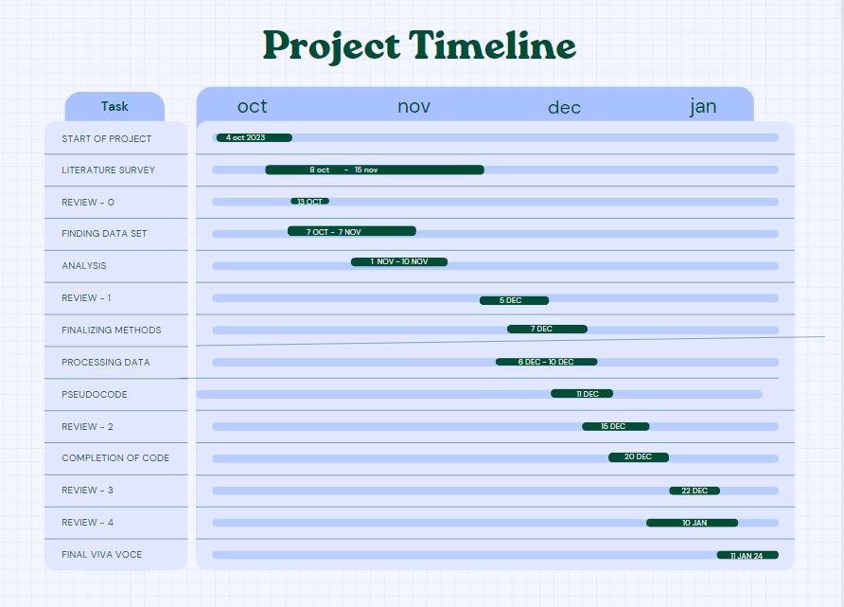
Timeline of the project:

Slide 16
Timeline of the project:
Sl. No | Review | Date | Scheduled Task
1 | Review-0 | 09-10-23 to 13-10-23 | Initial Project Planning
2 | Review-1 | 23-10-23 to 02-11-23 | Planning and Research
3 | Review-2 | 19-11-23 to 26-11-23 | Data Collection and Preprocessing, Model Implementation, Testing
4 | Review-3 | 13-12-23 to 25-12-23 | Optimization
5 | Viva-Voce | 20-01-25 to 22-01-25 | Deployment and Evaluation

Slide 17
Outcomes:
Enhanced User Experience:
Students and staff will have quick and easy access to information via the chatbot, reducing the need for manual inquiries.
The chatbot will streamline communication for frequently asked questions (FAQs) related to courses, schedules, fees, and campus services.
Real-Time Assistance:
Immediate responses to common student queries like exam schedules, campus events, and administrative procedures.
Integration with existing university systems for live data, ensuring up-to-date information.
Reduced Administrative Burden:
Automation of repetitive queries will allow administrative staff to focus on more complex tasks.
Faster response times and reduced reliance on human-operated inquiry desks.
Scalability:
The chatbot system can be easily expanded to handle more queries and different user groups, such as faculty, staff, and prospective students.
24/7 Availability:
The system will be available around the clock, ensuring support is accessible even after working hours, improving overall student satisfaction.
Cost-Effective Solution:
The chatbot will serve as a cost-effective solution to improve communication without the need for additional staffing resources.

Slide 18
Conclusion:
The development of the Presidency University chatbot aims to transform how students and staff access information, offering a seamless and automated communication platform. By providing real-time assistance, reducing the administrative burden, and ensuring 24/7 availability, the chatbot will enhance the overall user experience for students, faculty, and administration alike. Additionally, the scalability of the system allows for future growth and adaptation, ensuring the chatbot can evolve to meet the changing needs of the university. This project sets a foundation for modernizing campus services through digital innovation, delivering a user-friendly, efficient, and data-driven solution.

Slide 19
References (IEEE Paper format):
Project management: https://www.projectmanager.com/,https://www.smartsheet.com/
Development and Technology: https://ieeexplore.ieee.org/Xplore/home.jsp,https://chatbotsmagazine.com/
Testing and Quality Assurance:https://blogs.opentext.com/
Deployment and Maintenance: https://www.techrepublic.com/
Chat box development:
https://blog.hubspot.com/service/chatbotshttps://azure.microsoft.com/en-us/resources/cloud-computing-dictionary/what-is-a-chatbot/

Slide 20


